Slide 1
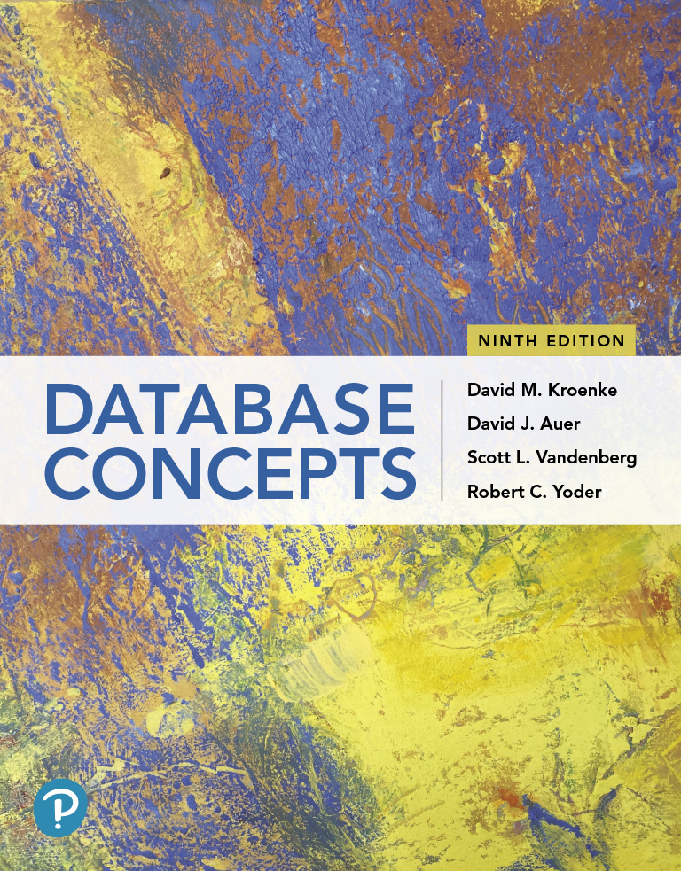
Database Concepts
Ninth Edition
Chapter 7
Data Warehouses, Business Intelligence Systems, and Big Data
Slide in this Presentation Contain Hyperlinks. JAWS users should be able to get a list of links by using INSERT+F7
Copyright © 2020, 2017, 2015 Pearson Education, Inc. All Rights Reserved
Notes:
If this PowerPoint presentation contains mathematical equations, you may need to check that your computer has the following installed:
1) Math Type Plugin
2) Math Player (free versions available)
3) NVDA Reader (free versions available)

Slide 2
Learning Objectives
Learn the basic concepts of data warehouses and data marts
Learn the basic concepts of dimensional databases
Learn the basic concepts of business intelligence (B I) systems
Learn the basic concepts of online analytical processing (O L A P)
Learn the basic concepts of virtualization and virtual machines
Learn the basic concepts of cloud computing
Learn the basic concepts of Big Data, structured storage, and the MapReduce process
Understand the limitations and tradeoffs of replicated, partitioned stores as indicated by the C A P (Consistency, Availability, Partition Tolerance) theorem
Learn the basic concepts of JavaScript Object Notation (J S O N) as a way of structuring nonrelational data

Slide 3
Big Data
Learn the basic concepts of data warehouses and data marts
Big Data is the current term for the enormous datasets generated by applications such as search tools like Google and Bing
Web 2.0 social networks include:
Facebook
LinkedIn
Twitter

Slide 4
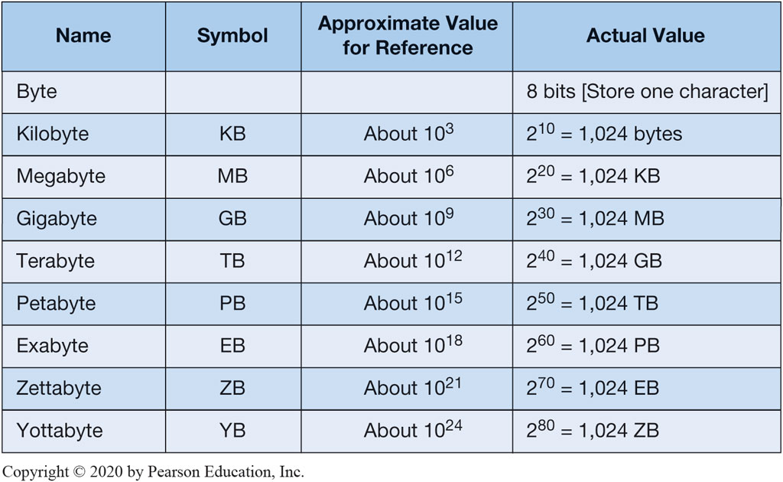
Figure 7.1 Storage Capacity Terms

Slide 5
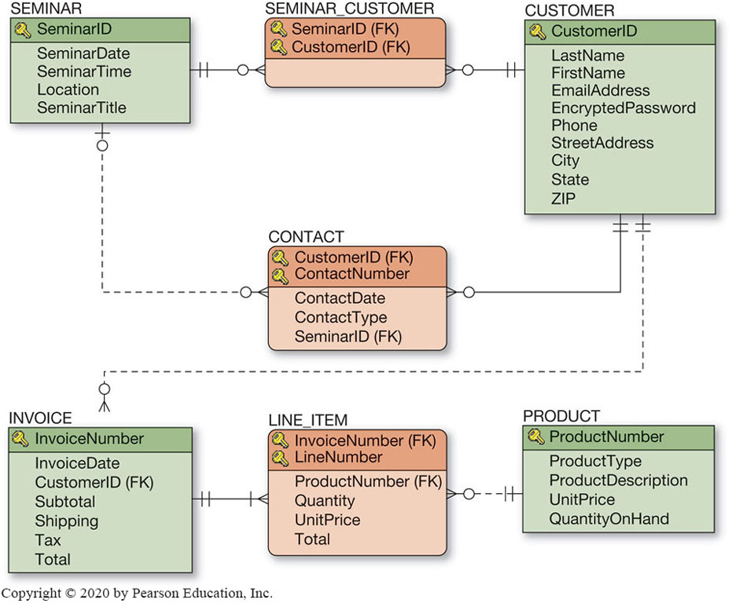
Figure 5.27 Heather Sweeney Designs: Database Design
Note: From Chapter 5 showing the final database design for Heather Sweeney

Slide 6
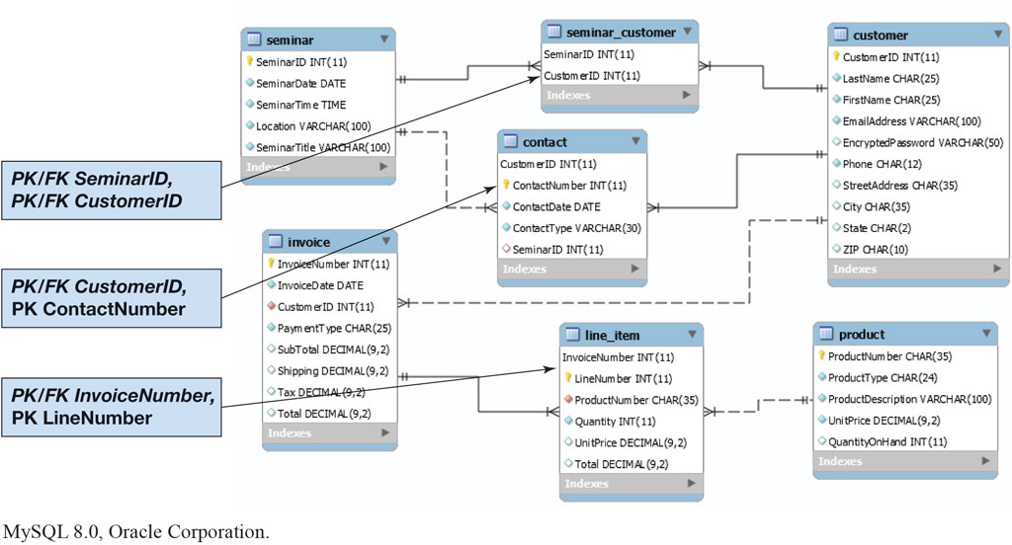
Figure 7.2 The H S D Database Diagram
Oracle MySQL Community Server 8.0, Oracle Corporation

Slide 7
Business Intelligence Systems
Learn the basic concepts of business intelligence (B I) systems
Business intelligence (B I) systems are information systems that:
assist managers and other professionals in the analysis of current and past activities and in the prediction of future events
do not support operational activities, such as the recording and processing of orders
these are supported by transaction processing systems
support management assessment, analysis, planning and control
B I systems fall into two broad categories:
reporting systems that sort, filter, group, and make elementary calculations on operational data
data mining applications that perform sophisticated analyses on data; analyses that usually involve complex statistical and mathematical processing

Slide 8
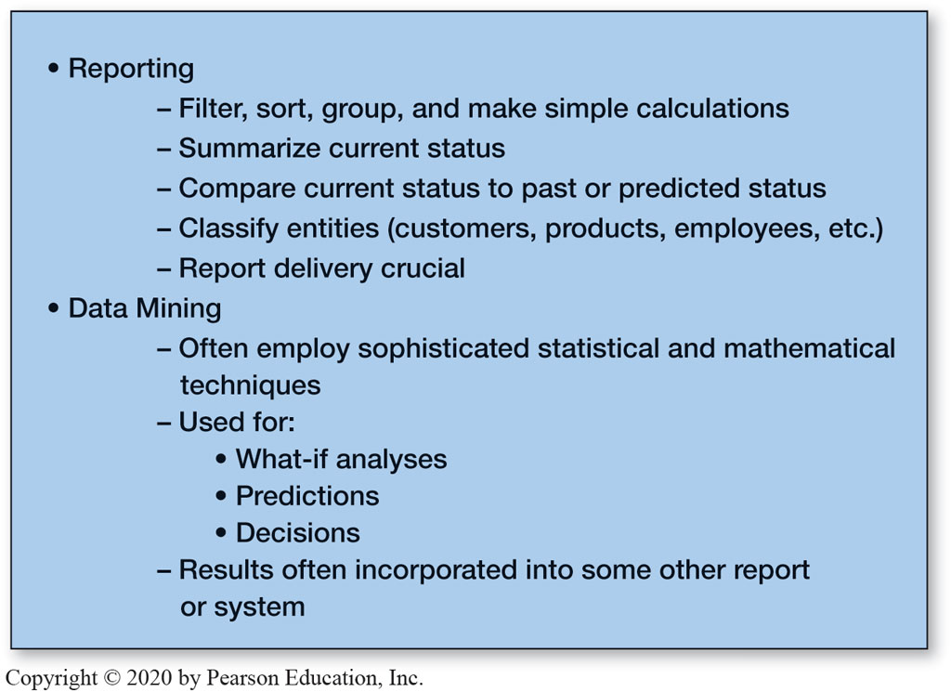
Figure 7.4 Characteristics of Business Intelligence Applications

Slide 9
B I Terms
Learn the basic concepts of business intelligence (B I) systems
Online analytical processing (O L A P) is the processing of non-operational data used in data mining and other applications
Data lake is a repository that includes all data relevant to a business (re: photos, documents, other files of any type)
A data warehouse is a database system that has data, programs, and personnel that specialize in the preparation of data for B I processing.

Slide 10
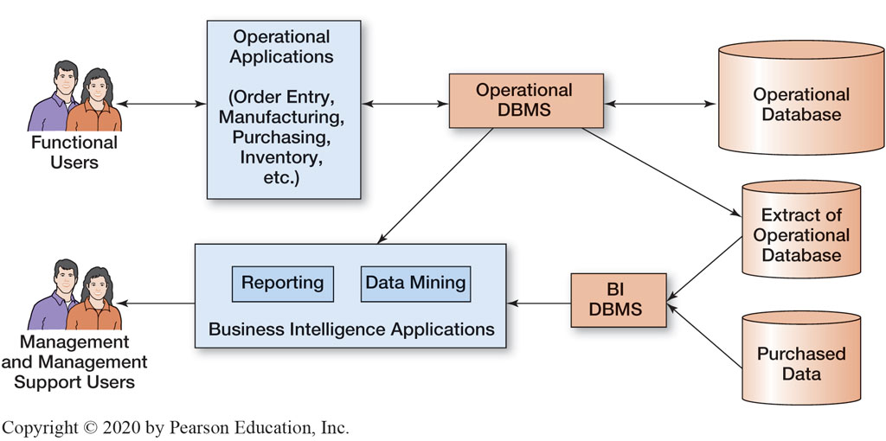
Figure 7.3 The Relationship Between Operational and B I Applications

Slide 11
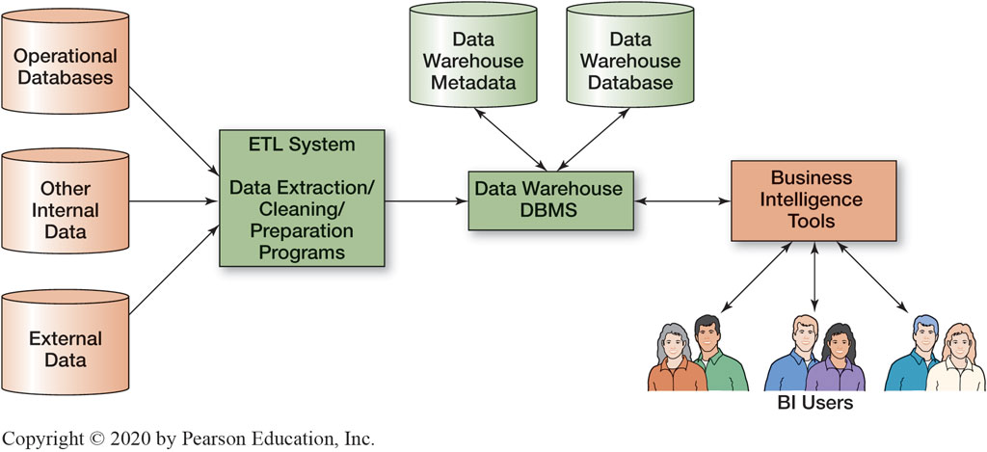
Figure 7.5 Components of a Data Warehouse

Slide 12
Problems with Operational Data
Learn the basic concepts of business intelligence (B I) systems
“Dirty data,” examples include:
“G” for gender
“213” for age
Missing values
Inconsistent data
data that has changed (ex: customer’s phone number)
Nonintegrated data (data from multiple sources)
Incorrect format (ex: too many or not enough digits
Too much data (ex: an excess number of columns)

Slide 13
E T L Data Transformation
Learn the basic concepts of business intelligence (B I) systems
Data may need to be transformed for use in a data warehouse. For example:
{CountryCode → CountryName}
“U S” → “United States”
Email address to Email domain
joe@somewhere.com → “somewhere.com”

Slide 14
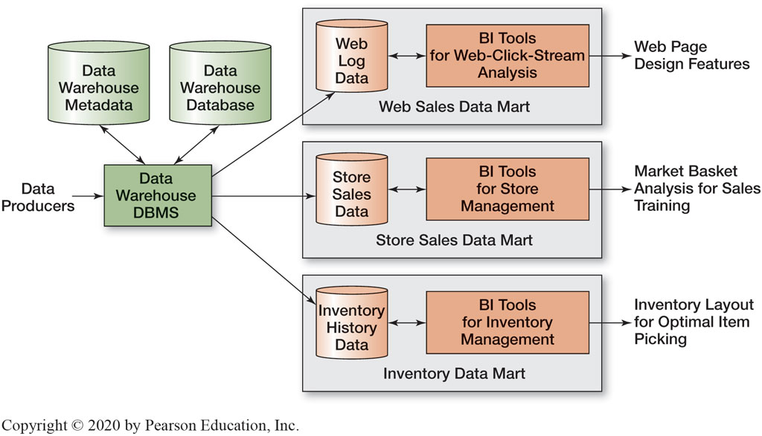
Figure 7.6 Data Warehouses and Data Marts

Slide 15
Data Warehouses Versus Data Marts
Learn the basic concepts of data warehouses and data marts
A data mart is a collection of data that is smaller than the data warehouse that addresses a specific component
An enterprise data warehouse (E D W) architecture is when a data mart is combined with the data warehouse architecture.

Slide 16
Figure 7.7 Characteristics of Operational and Dimensional Databases
A dimensional database is a design used for efficient analysis and efficient queries for data warehouses.
Uses a star-schema with a fact table at the center (fully normalized) and a dimensional table radiating out from the center (may be non-normalized)
May use slowly changing dimensions to track data such as a date or time dimension.
Operational Database | Dimensional Database
Used for structured transaction data processing | Used for unstructured analytical data processing
Current data are used | Current and historical data are used
Data are inserted, updated, and deleted by users | Data are loaded and updated systematically, not by users

Slide 17
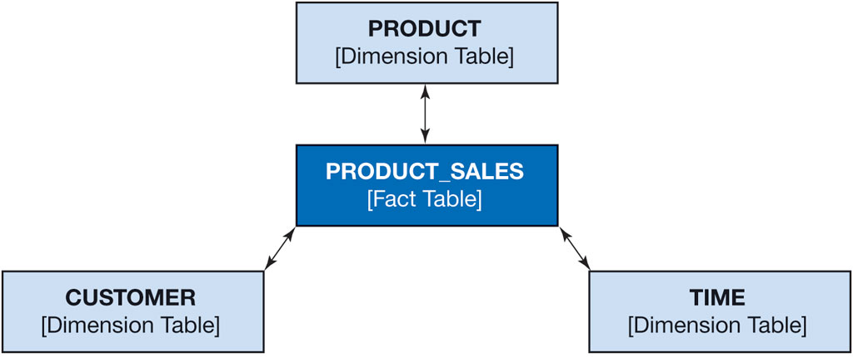
Figure 7.8 A Star Schema

Slide 18
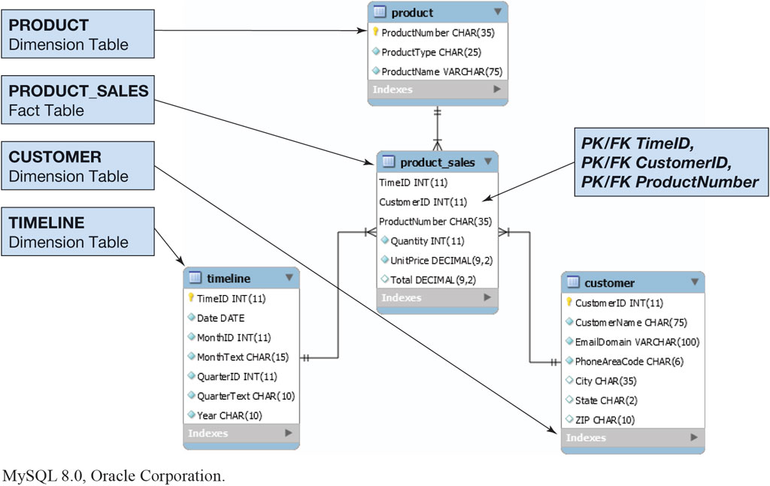
Figure 7.9 The H S D – D W Star Schema
Oracle MySQL Community Server 8.0, Oracle Corporation

Slide 19
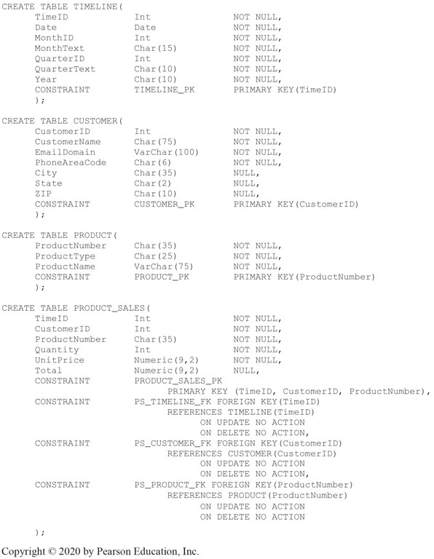
Figure 7.10 The H S D – D W SQL Create Table Statements

Slide 20
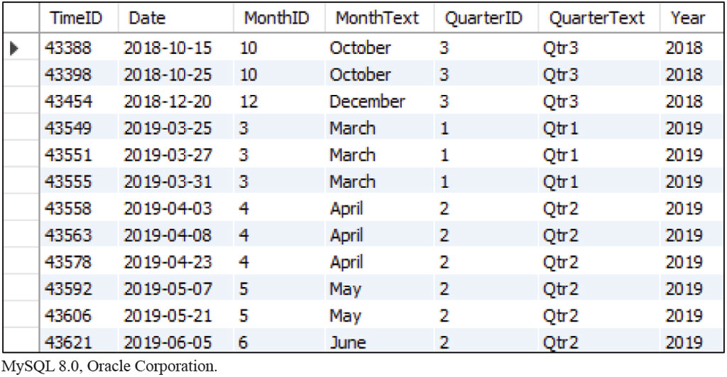
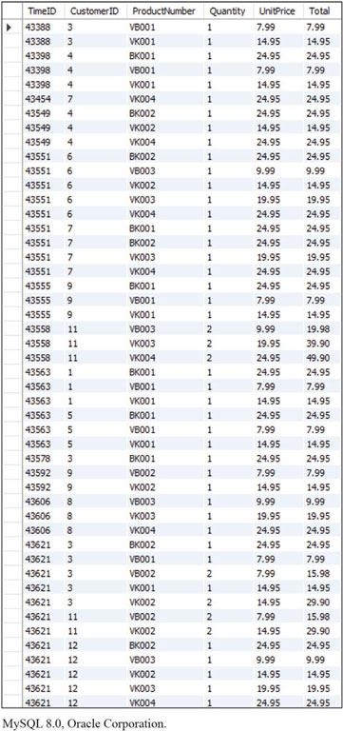
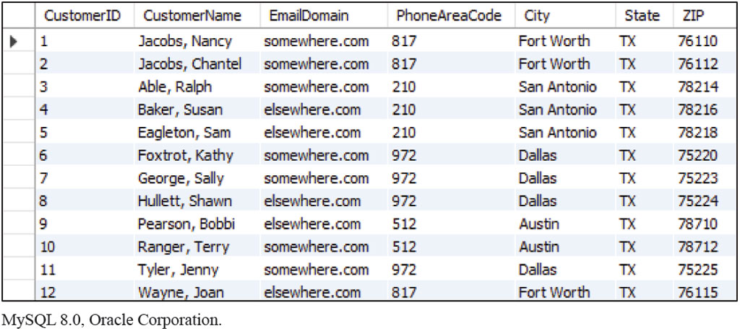
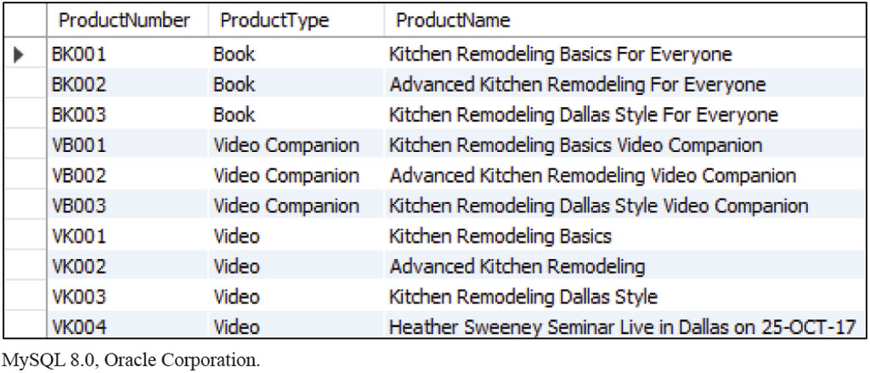
Figure 7.11 The H S D – D W Table Data
Oracle MySQL Community Server 8.0, Oracle Corporation

Slide 21
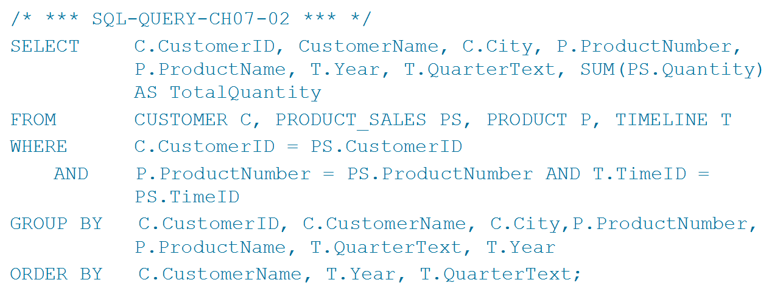
A Query to Summarize Products Sold by Customer and Product
Learn the basic concepts of business intelligence (B I) systems
The following SQL code is used to summarize products sold by Customer and Product

Slide 22
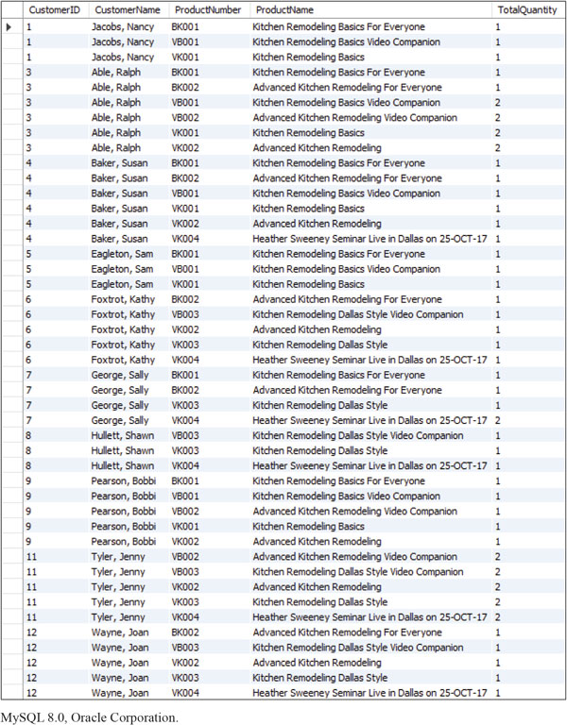
Figure 7.12 The H S D – D W Query Results: Summarize Product Units Sold by Customer and Product
Oracle MySQL Community Server 8.0, Oracle Corporation

Slide 23
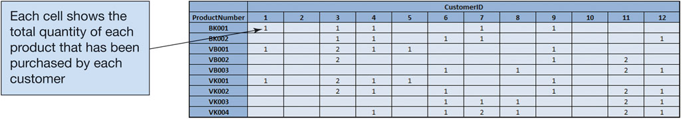
Figure 7.13 The Two-Dimensional ProductNumber-CustomerID Matrix

Slide 24
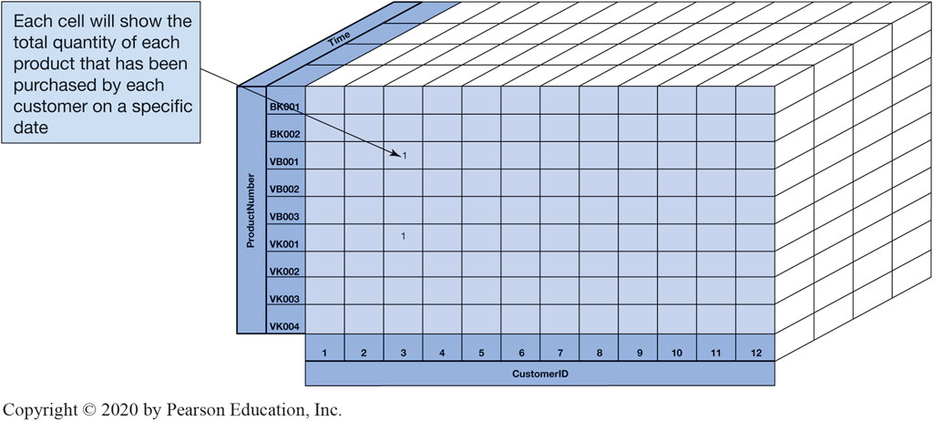
Figure 7.14 The Three-Dimensional Time-ProductNumber-CustomerID Cube

Slide 25
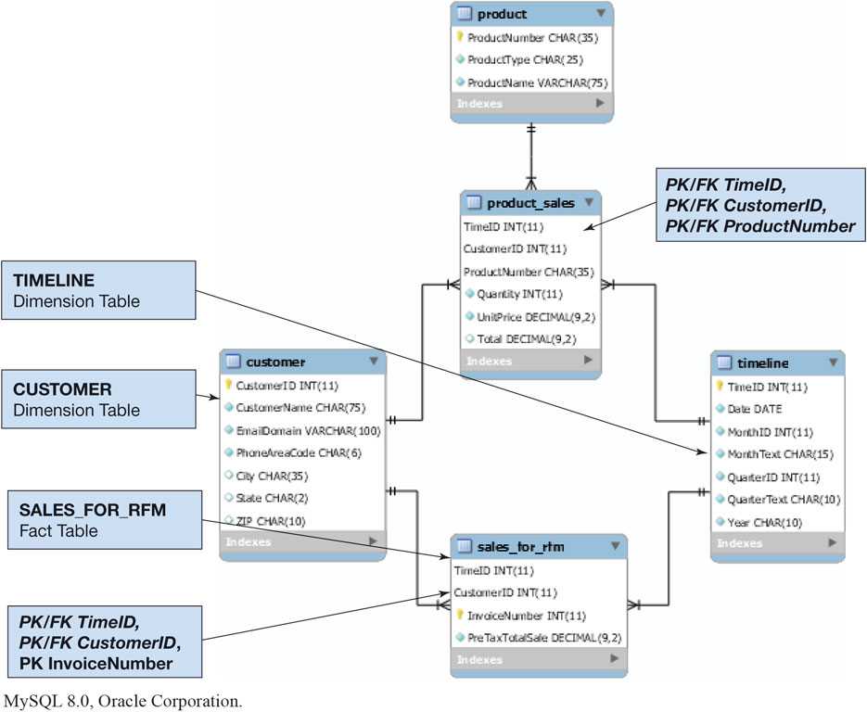
Figure 7.15 The H S D – D W Star Schema Extended for R F M Analysis
Oracle MySQL Community Server 8.0, Oracle Corporation

Slide 26
Online Analytical Processing (O L A P)
Learn the basic concepts of online analytical processing (O L A P)
Online Analytical Processing (O L A P) is a technique for dynamically examining database data:
O L A P uses arithmetic functions such as Sum and Average
O L A P uses the dimensional database model
O L A P systems produce O L A P reports (also called O L A P cube)
An O L A P report uses inputs call dimensions
An O L A P report calculates outputs called measures
Excel PivotTables can be used to create O L A P reports

Slide 27
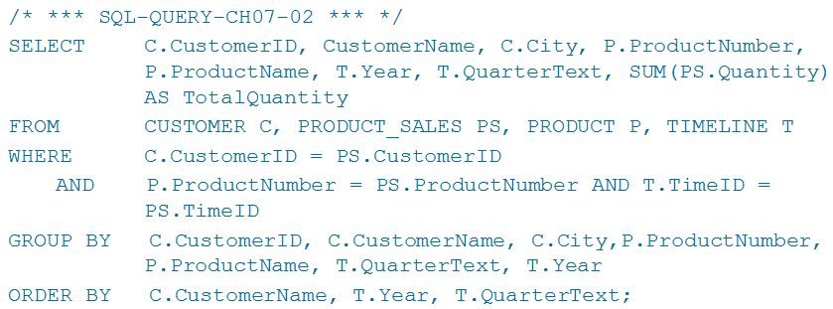
S Q L Query for O L A P Data
Learn the basic concepts of online analytical processing (O L A P)

Slide 28
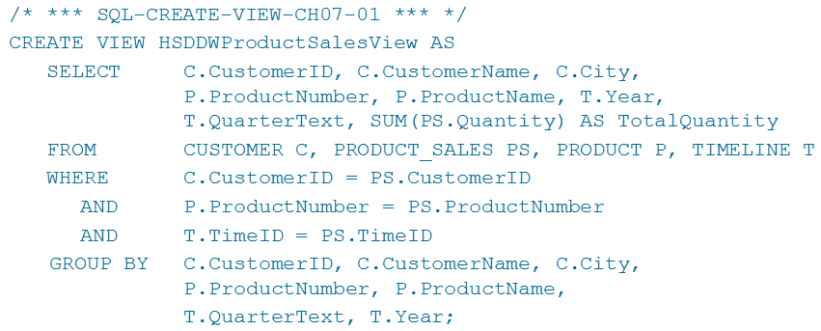
SQL View for O L A P Data
Learn the basic concepts of online analytical processing (O L A P)

Slide 29
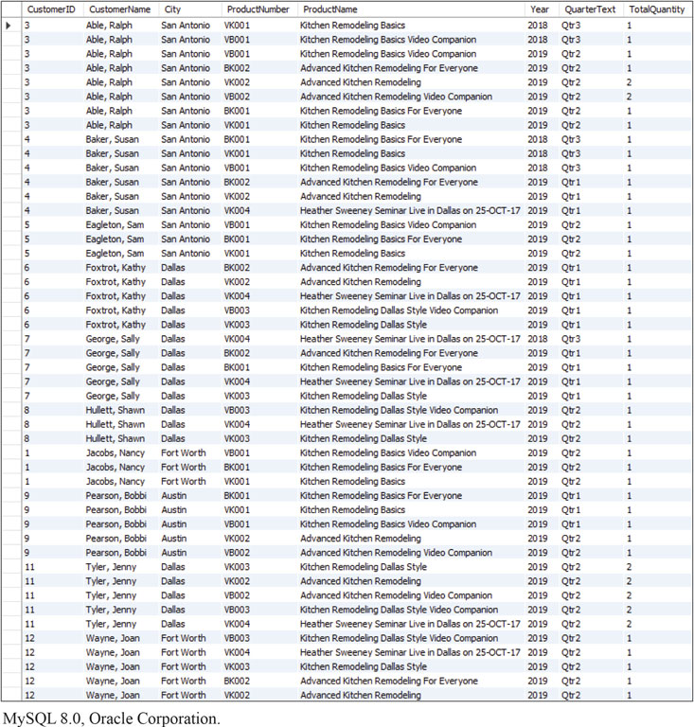
Figure 7.16 The H S D-D W Query for O L A P Results: Time-Product-Customer Cube
Oracle MySQL Community Server 8.0, Oracle Corporation

Slide 30
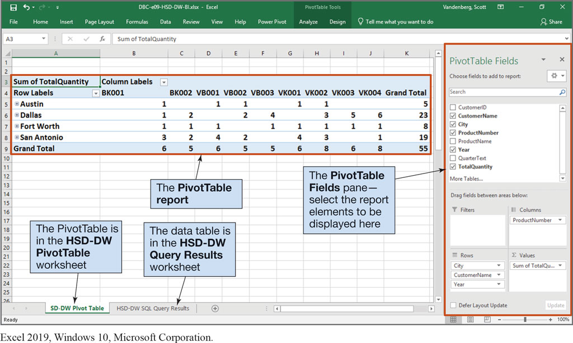
Figure 7.17 The H S D-D W O L A P ProductNumber by City Report
Excel 2019, Windows 10, Microsoft Corporation

Slide 31
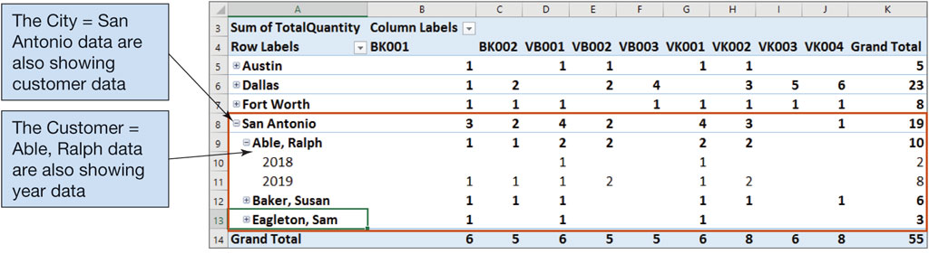
Figure 7.18 The H S D – D W O L A P ProductNumber by City Report: CustomerName and Year Dimensions Added
Excel 2019, Windows 10, Microsoft Corporation

Slide 32
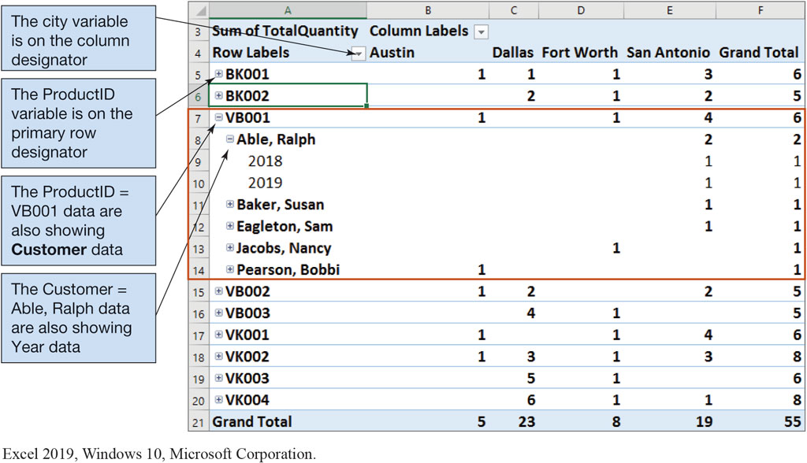
Figure 7.19 The H S D – D W O L A P City by ProductNumber, CustomerName, and Year Report
Excel 2019, Windows 10, Microsoft Corporation

Slide 33
Distributed Database Processing
Learn the basic concepts of virtualization and virtual machines
A distributed database is a database that is stored and processed on more than one computer.
A service cluster is a group of associated servers where the database shared between them is called a distributed database.
A database is distributed when it is:
partitioned
replicated
both partitioned and replicated
Databases are distributed for two major reasons – performance and control.

Slide 34
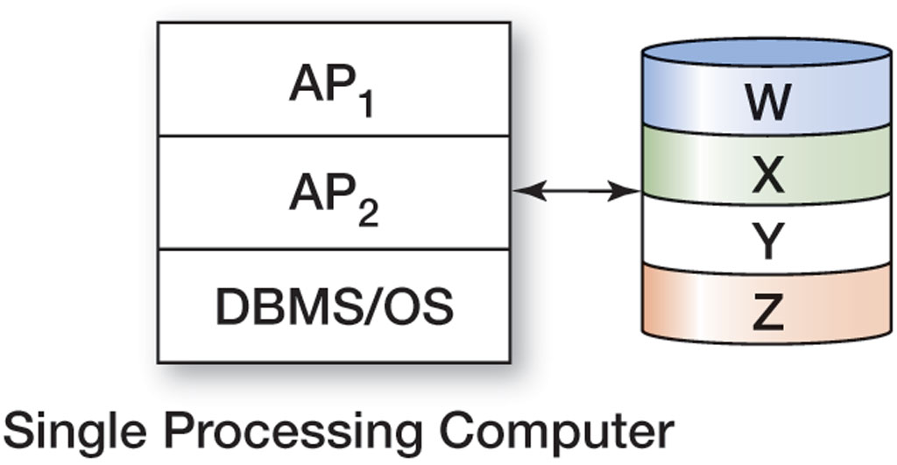
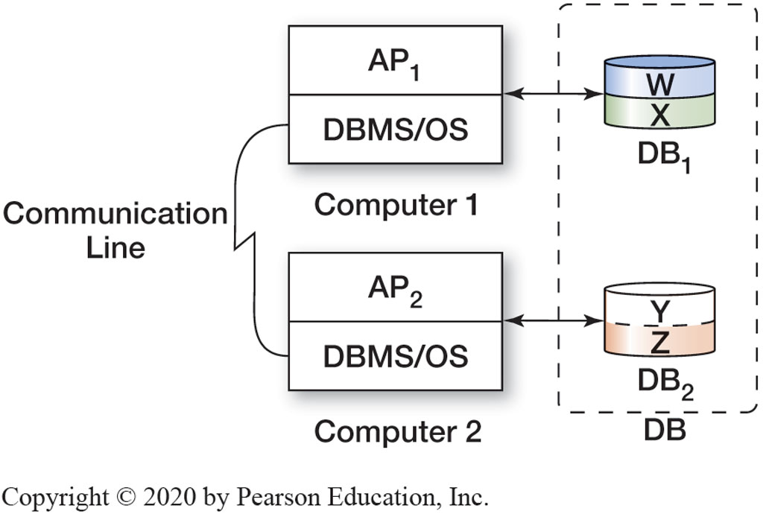
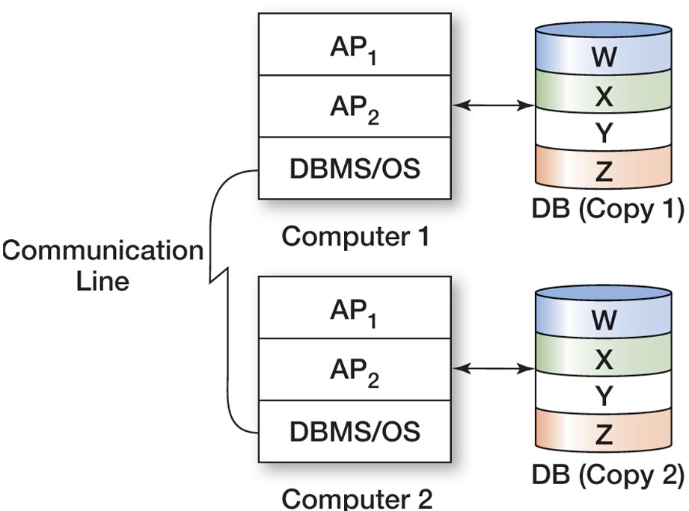
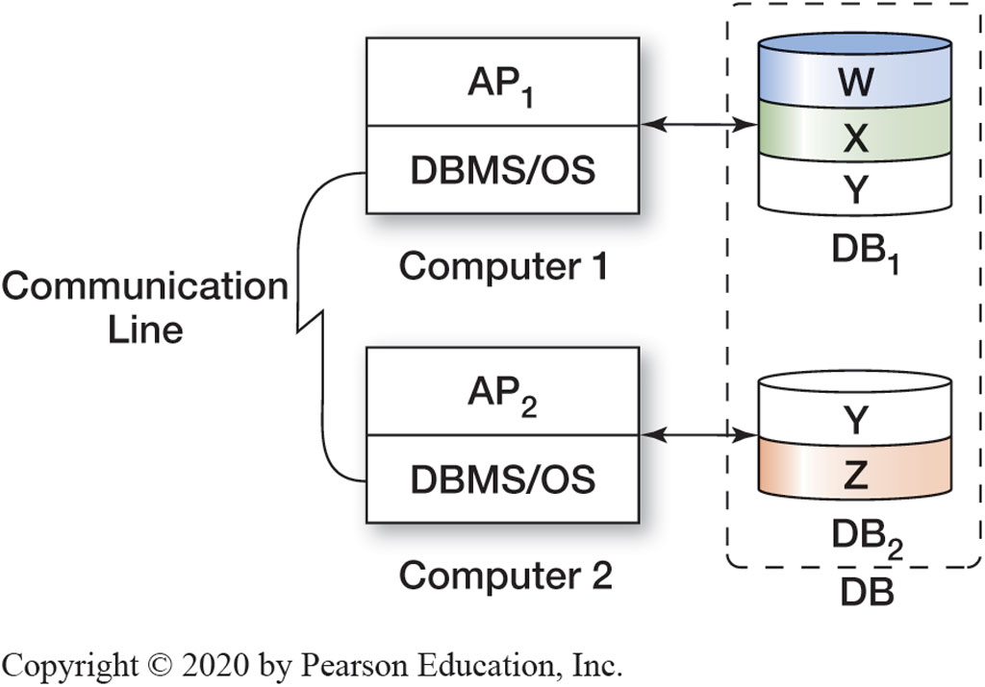
Figure 7.20 Types of Distributed Databases

Slide 35
Object-Relational Databases
Learn the basic concepts of virtualization and virtual machines
Object-oriented programming (O O P) is a methodology for designing and writing computer programs.
Some object-oriented programming languages are Java, Python, C++, C#, and Visual Basic.NET
Objects are data structures that have both methods (programs that perform some task with the object) and properties (data items particular to an object).
Object persistence is the permanent storing of values of properties of an object in secondary memory (usually disk)

Slide 36
O O D B M S
Learn the basic concepts of virtualization and virtual machines
Object-oriented DBMSs (O O D B M Ss) are special-purpose D B M S products for storing data developed by several vendors in the early 1990s. These never achieved commercial success.
too expensive to transfer existing data from traditional legacy databases
not cost justifiable

Slide 37
Virtualization
Learn the basic concepts of virtualization and virtual machines
Virtualization is using hardware and software to simulate another hardware resource.
Virtualization is done by having one physical computer host one or more virtual computers, also known as virtual machines.
The host machine runs a special program known as a virtual machine manager or hypervisor.
There are two ways to implement hypervisors:
“bare metal” or type 1 (used in large data centers)
“hosted” or type 2 (used by students and others)

Slide 38
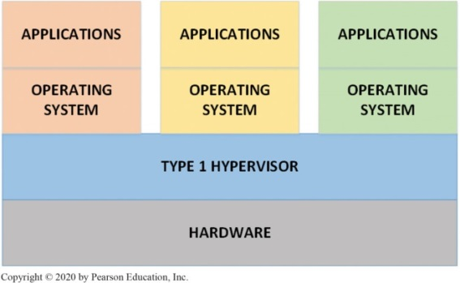
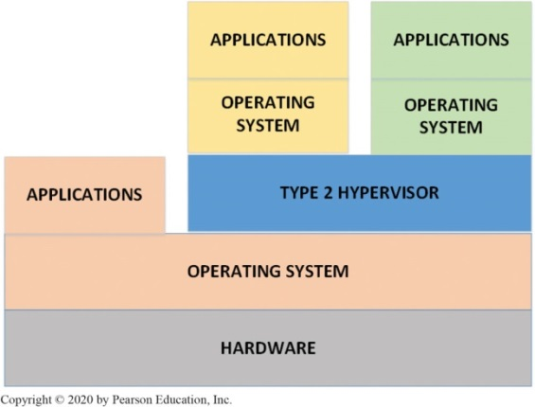
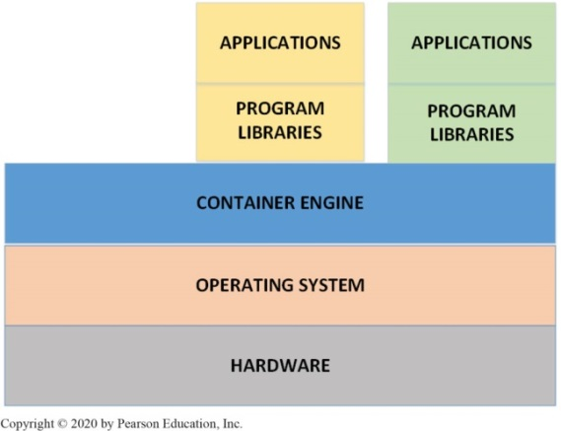
Figure 7.21 Type 1 and Type 2 Hypervisors versus Containers

Slide 39
Cloud Computing
Learn the basic concepts of cloud computing
Cloud computing services are ultimately provided by large data centers.
Storage area networks (S A N s) have dedicated network paths from servers to disk arrays, where several physical disks are combined together to act as a single, larger disk.
Redundant arrays of independent disks (R A I D) can be configured for maximum access speed or for reliability.
Three basic ways to lease cloud services:
Software as a service (SaaS), Ex: Salesforce.com
Platform as a service (PaaS), Ex: operating systems, software development tools & system programs provided
Infrastructure as a service (IaaS), Ex: Only hardware provided and users manage their own software

Slide 40
Not Only SQL
Learn the basic concepts of Big Data, structured storage, and the MapReduce process
The Not only SQL (previously NoSQL) movement is a movement to use non-relational databases.
These databases are often a distributed, replicated database to support large datasets.

Slide 41
The C A P Theorem
Understand the limitations and tradeoffs of replicated, partitioned stores as indicated by the C A P (Consistency, Availability, Partition Tolerance) theorem
The C A P theorem defines three properties of distributed database systems:
Consistency means that all database replicas see the same data at any given point in time
Availability means that every request received by a server will result in a response, as long as the network is available
Partition tolerance means that the distributed database can continue to operate even when the cluster is partitioned by network failures into two or more disconnected sections (partitions)

Slide 42
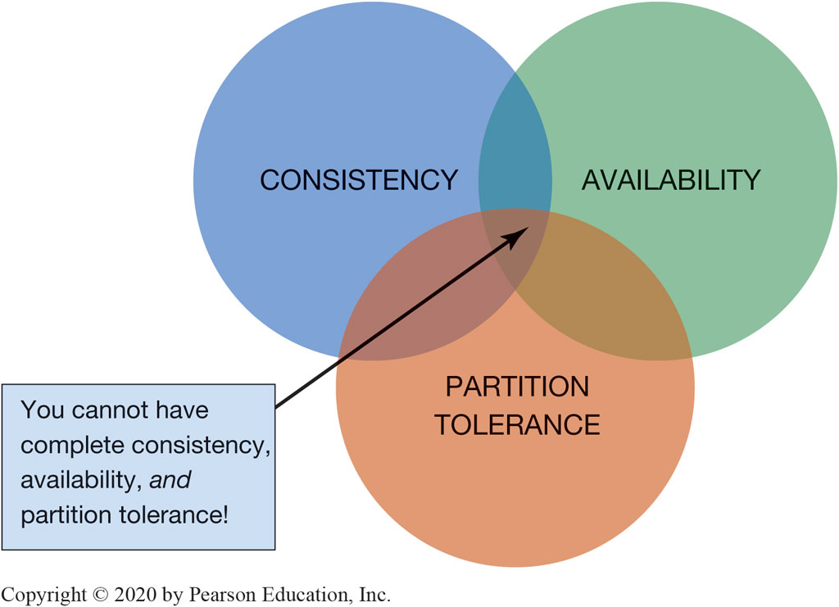
Figure 7.22 The C A P Theorem—You Can’t Have All Three at the Same Time!

Slide 43
Categories of NoSQL Database Management Systems
Learn the basic concepts of Big Data, structured storage, and the MapReduce process
Four categories of NoSQL databases include:
Key-Value database
Dynamo, MemcacheDB, Redis
Document database
Couchbase, ArangoDB, Mongo DB
Column family database
Vertica, Apache Cassandra, Hbase
Graph database
Neo4j, AllegroGraph, Titan

Slide 44
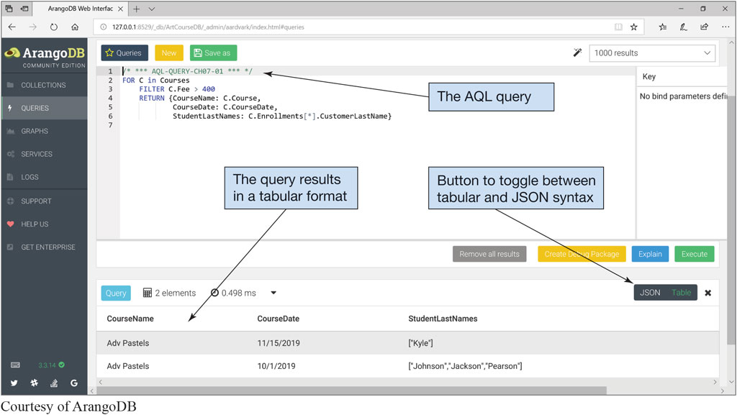
Figure 7.23 An ArangoDB AQL Query and J S O N Results
Courtesy of ArangoDB

Slide 45
MapReduce and Hadoop
Learn the basic concepts of Big Data, structured storage, and the MapReduce process
MapReduce is a technique to analyze extremely large datasets by breaking down tasks and assigning them to a cluster of computers and then combine them into the final product of the original task.
Hadoop Distributed File System (H D F S) provides standard file services to clustered servers so their file systems can function as one distributed, replicated file system that can support large-scale MapReduce processing.

Slide 46
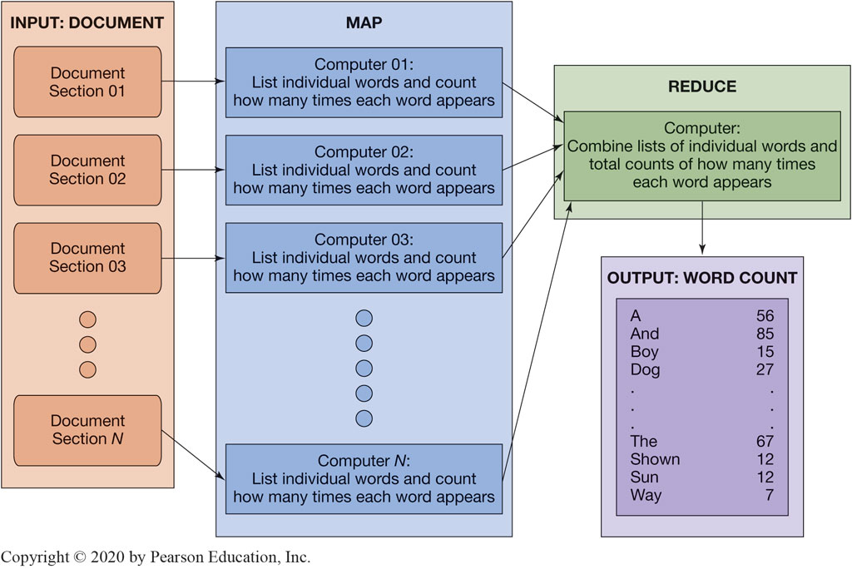
Figure 7.24 MapReduce

Slide 47
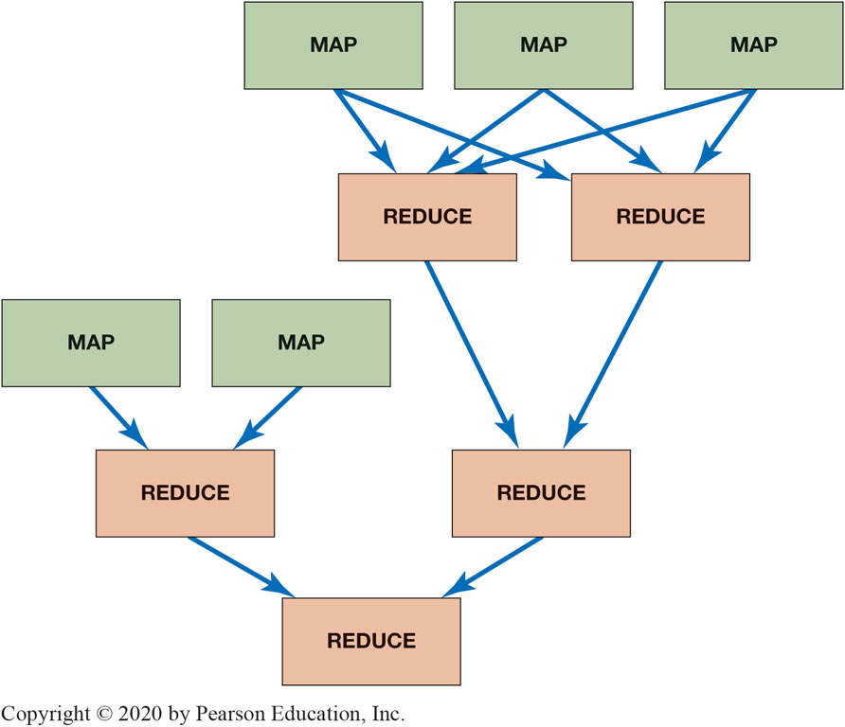
Figure 7.25 Example of Apache Tez Directed Acyclic Graph

Slide 48

Copyright
This work is protected by United States copyright laws and is provided solely for the use of instructors in teaching their courses and assessing student learning. Dissemination or sale of any part of this work (including on the World Wide Web) will destroy the integrity of the work and is not permitted. The work and materials from it should never be made available to students except by instructors using the accompanying text in their classes. All recipients of this work are expected to abide by these restrictions and to honor the intended pedagogical purposes and the needs of other instructors who rely on these materials.

